Slide 1
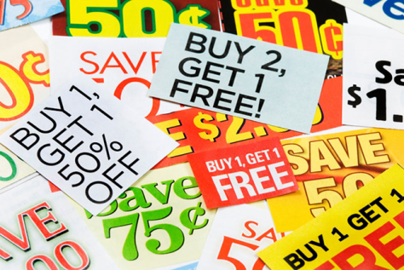
Lecture 13 Advertising and Sales Promotion

Slide 2
Communication Models in a Digital World That is “Always On”
Marketing messages can assume many forms with a variety of objectives.
From quirky TV commercials and viral videos to blimps with blinking messages
Savvy marketers know each element of the marketing mix is a form of communication!
All marketing communications aim to either inform, remind, persuade, or build relationships.

Slide 3
Integrated Marketing Communications (IMC)
Integrated marketing communication (IMC) involves the planning, execution, and evaluation of coordinated, brand communication programs over time to targeted audiences.
Aim is to deliver consistent messaging across platforms.
Must use a multichannel promotion strategy which combines traditional marketing communication with social media and other online activities.

Slide 4
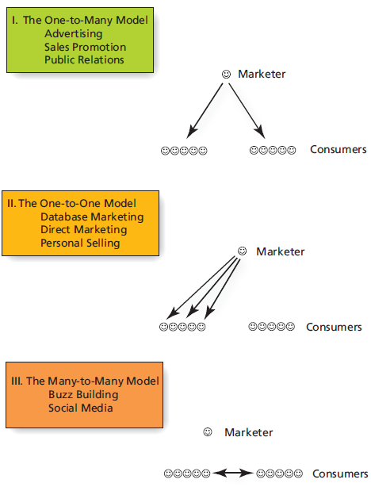
Three Models of Marketing Communication
Notes:
The one-to-many model relies on traditional forms of mass communication, such as TV, radio, magazine, and newspaper advertising, billboards and other out-of-home advertising, and Internet advertising to reach literally millions of people. Sales promotions such as coupons, samples, rebates and more are also part of this model, as are event and sponsorship marketing, and brand-related publicity efforts.
The one-to-one model expands upon the traditional model by recognizing the importance and contributions of personal selling, direct marketing, and database marketing.
By contrast, the many-to-many model of communication recognizes the need to update communication methods to account for changes in our now “wired” world. Social network marketing and word-of-mouth communication, both F2F and online, are incorporated into this model of communication. Viral marketing, evangelical marketing, and product review sites also play a role in the many-to-many model.

Slide 5
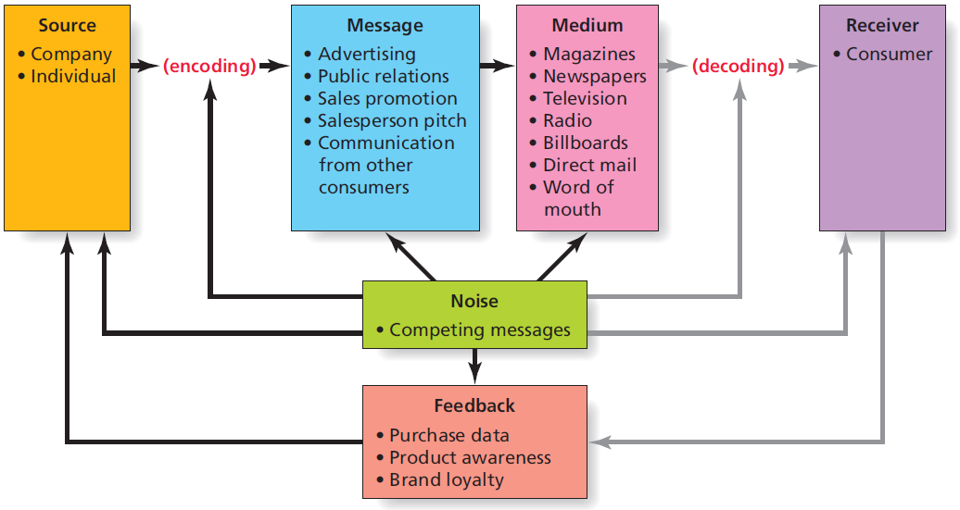
Communication Framework
Notes:
SOURCE: Is the firm or person sending a message. Within a marketing communication execution, the source could also be considered to be the person who is delivering the information, such as the sales representative, actor, celebrity endorser, or actual consumer.
ENCODING: Refers to the transmission of an idea into a form of communication that conveys meaning to the receiver.
MESSAGE: The message is simply the physical form of the communication that goes from a sender to a receiver. Messages may contain both verbal (ad copy, script that is read) and nonverbal elements (visual scenery, etc.).
MEDIUM: Television, radio, salespeople, an Internet blog are just some examples of the various media that marketers can use to transmit the message. Choosing the medium is important as marketers must make certain that the target market is exposed to the medium, and that the attributes or benefits of the advertised product or service are compatible with the medium.
RECEIVERS: Are the target of the communication. They may be consumers, other businesses, or news outlets, to name just a few. Assuming that the receiver has paid attention to the message, to successfully decode the message, the receiver and source must share a mutual frame of reference, otherwise miscommunication occurs.
If receivers are to be able to successfully DECODE the message, the words/images/etc. chosen to form the message must be capable of communicating the shared meaning. This ensures that the message as encoded is properly interpreted when decoded by the receiver. Cultural, geographic, and educational differences among receivers can influence the extent to which the message meaning is shared, and thus is properly decoded. The receiver will interpret the message in light of his or her unique experiences.
NOISE is simply anything that interferes with the transmission or decoding of the message. Noise may LITERALLY be noise, such as when a hungry infant screams for her bottle, distracting her mother’s attention from the TV and the advertisement being shown. Noise may also occur when the satellite feed breaks down due to heavy cloud cover, or take the form of clutter – competing marketing communications that vie for the consumers attention. Noise can actually occur at ANY stage in the communication process. Marketers try to minimize noise when they place messages in media where there is less likely to be distractions or alternative messages from the competition.
FEEDBACK from the receiver to the source is a desirable outcome of the communication process. Some feedback is indirect and tracked via measures related to the goals of the marketing communications campaign (e.g., coupon redemptions, contest entries). Other types of feedback are more direct (phone calls, email messages, survey completions, product registrations, etc.). If consumers are unhappy, they may eagerly provide feedback. Marketers should be certain to encourage feedback by offering toll-free phone numbers or email addresses where consumers can voice their concerns or praise.

Slide 6
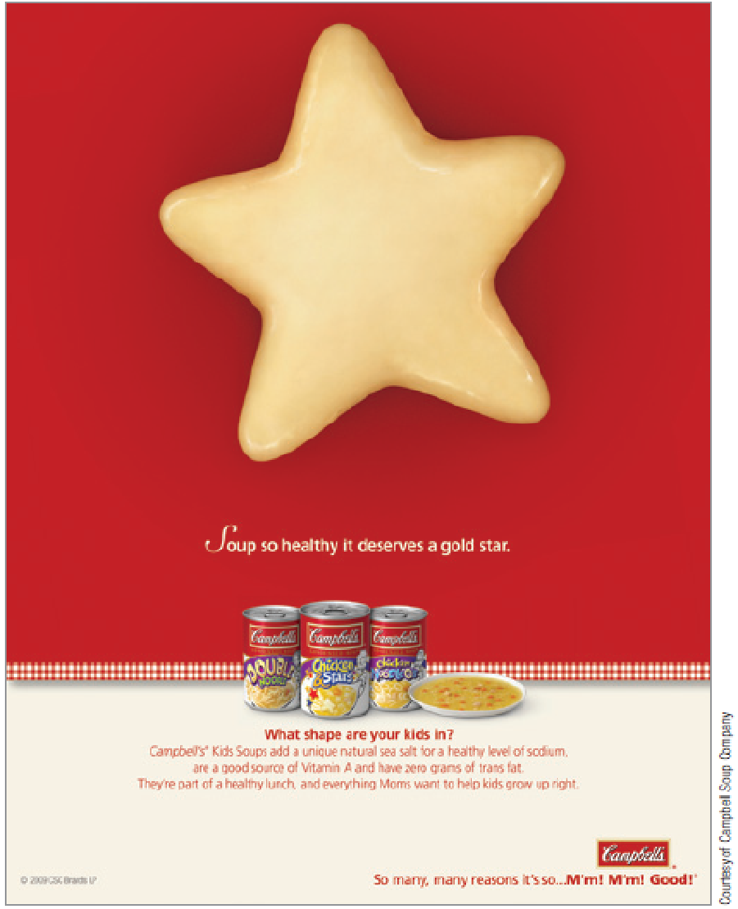
The Source Encodes
Process begins with a source with an idea that they want to communicate to a receiver.
Encoding is the process by which the idea is translated into a physically perceivable form that conveys meaning.
Words, music, and images
Spokespeople
Animated characters

Slide 7
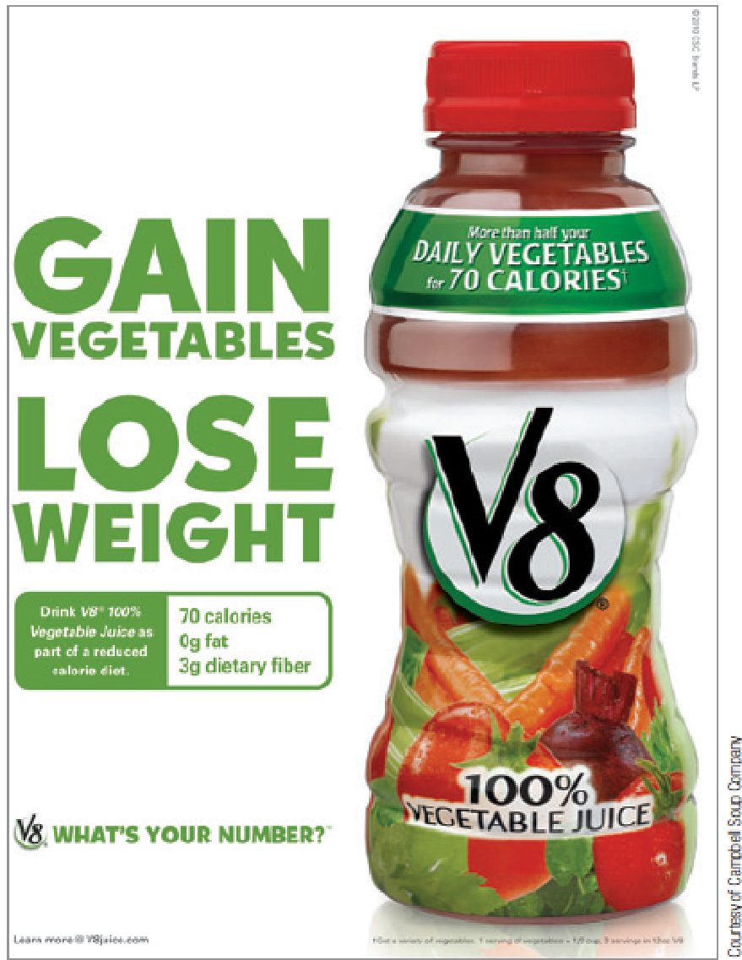
The Message
The message is the actual content of communication that goes from the source to a receiver.
May be in the form of:
Advertising
Sales promotion
A salesperson’s pitch
Infomercial
Websites, social media, blogs, search engines
Word of mouth

Slide 8
The Medium
The medium is the communication vehicle that reaches members of the target audience.
Marketers face two major challenges :
Target market exposure to medium
Product characteristics are not in conflict with the medium.

Slide 9
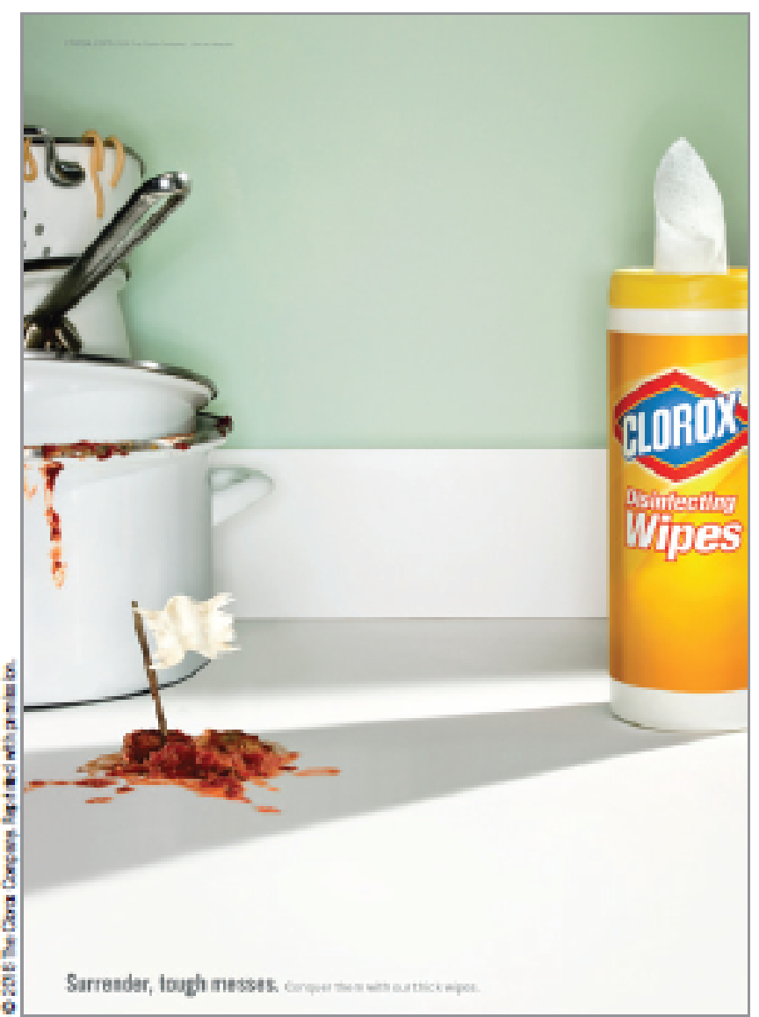
The Receiver Decodes
For effective decoding to occur, the source and the receiver must share a frame of reference.
In this ad, the receiver needs to understand the meaning of the “white flag” in order for the message to make sense.

Slide 10
Noise and Feedback
The communication model also acknowledges that noise—anything that interferes with effective communication—can block messages.
To complete the communication loop, the source gets feedback from receivers.

Slide 11
The Traditional Promotional Mix
Promotion mix refers to communication elements that the marketer controls.
Mass (one-to-many) communication: includes advertising, sales promotion, and public relations.
Personal (one-to-one) communication: includes personal selling and direct marketing.

Slide 12
Mass Communications: The One-to-Many Model
Some elements of the promotion mix include messages intended to reach many prospective customers at the same time.
Advertising
Consumer sales promotion
Public relations

Slide 13
Personal Communications: The One-to-One Model
Marketers may sometimes prefer to communicate on a personal level.
Personal selling
Direct mail
Telemarketing
Direct marketing

Slide 14
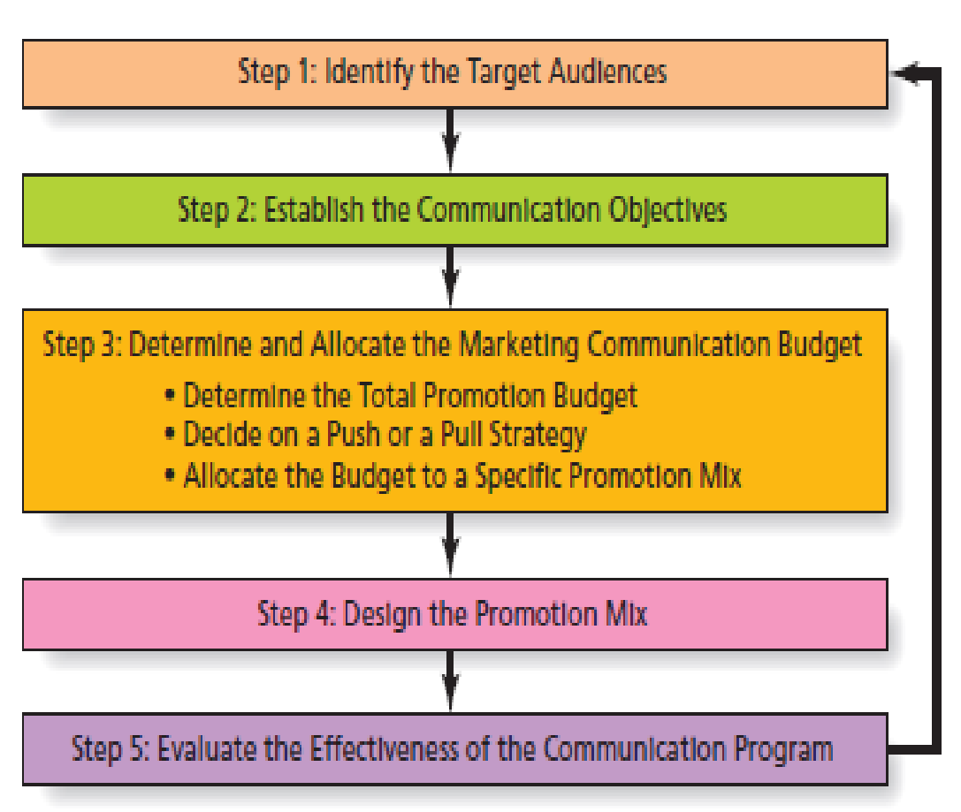
Steps to Develop the Promotional Plan

Slide 15
Advertising
Advertising is non-personal communication from an identified sponsor using mass media.
Practice dates to ancient Greece and Rome.
Changes in media landscape have slowed growth of traditional advertising …
But mass communications remains the best way to reach a large audience
TV Everywhere (also known as Authenticated Streaming) is the use of an internet-enabled device, like a tablet or smartphone, to stream content from a cable or satellite provider.

Slide 16
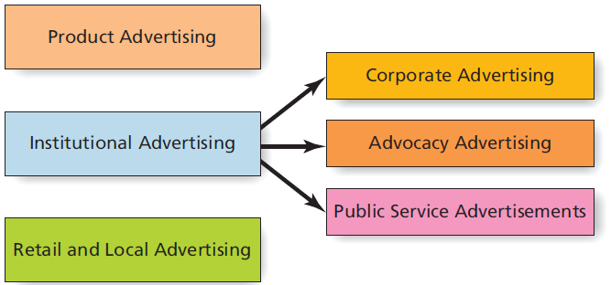
Types of Advertising
Notes:
Product advertising focuses on a specific good or service and constitutes the bulk of most advertising. This includes brand image advertising, as well as those ads that seek to create awareness of new brands or brand features and benefits, or remind consumers about an existing brand.
Institutional advertising promotes the activities, personality, or point of view of an organization or company and includes three subtypes.
Corporate advertising seeks to promote the company as a whole, rather than any one specific brand. Very often corporate ads seek to create goodwill toward the firm, or improve its overall image. British Petroleum engaged in a great deal of corporate advertising following the malfunction of a deepwater oil drill in 2010 that resulted in an enormous amount of oil being poured into the Gulf for several months.
Advocacy advertising is a type of public service advertising where the firm actually tries to influence public opinion on some issue because it has a stake in the outcome. The U.S. government had engaged in advocacy advertising to promote climate change.
Public service announcements (PSA) are run for free by the media because the ads support not-for-profit organizations, or because they champion a cause or change for the greater societal good. The Ad Council has been involved in creating many of the most memorable public service campaigns.
Retail and local advertising is simply the designation used to describe ads run by both major retailers and small businesses within a given geographic market.

Slide 17
User-Generated Advertising Content
User-Generated Content (UGC) includes the millions of product-related comments, reviews, photos, images, and videos posted online by consumers.
Some marketers encourage consumers to contribute their own DIY ads (e.g., Dorito’s “Crash the Super Bowl” contest).
Crowdsourcing can help select a winning ad or even create one (Ford’s “Fiesta Movement” campaign).
Notes:
Often the best promotional approach is let your customers do the work for you! UGC includes the millions of online consumer comments, opinions, advice, consumer-to-consumer discussions, reviews, photos, images, videos, podcasts and webcasts, and product-related stories available to other consumers through digital technology.
Some marketers encourage consumers to contribute their own DIY ads (see video and discussion note on Doritos Crash the Super Bowl ad contest).
For advertisers, DIY advertising offers several benefits. First, consumer-generated spots cost only one-quarter to one-third as much as professional TV and Internet ads—about $60,000 compared to the $350,000 or more to produce a traditional 30-second spot. This can be especially important for smaller businesses and emerging brands.
Equally important, even to large companies with deep pockets, is the feedback on how consumers see the brand and the chance to gather more creative ideas to tell the brand’s story.
Crowdsourcing, the practice of outsourcing marketing activities to users that we discussed in Chapter 6, also can help either select a winning ad or even create one.

Slide 18
Ethical Issues in Advertising
Advertising, more than any other aspect of marketing, has been criticized as unethical.
Advertising is manipulative,
is deceptive and untruthful,
is offensive and in bad taste, and
causes people to buy things they don’t really need.
Corrective advertising clarifies or qualifies previous deceptive advertising claims.
Puffery relates to claims made in advertising of product superiority that cannot be proven true or untrue.
Greenwashing is a practice in which companies promote their products as environmentally friendly when in truth the brand provides little ecological benefit.

Slide 19
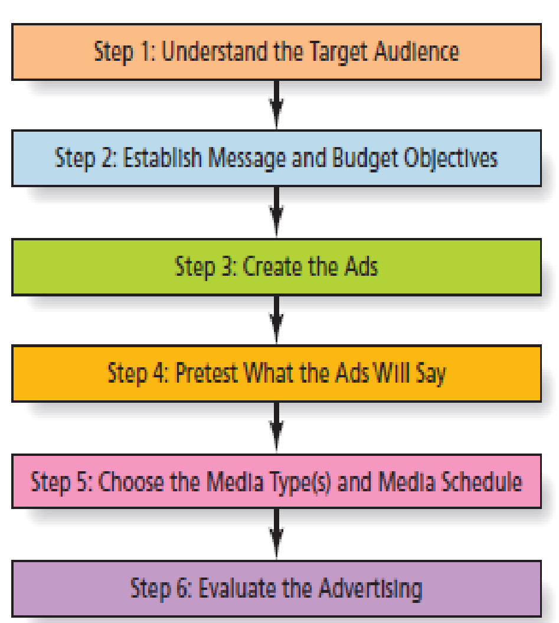
Steps to Develop an Advertising Campaign

Slide 20
Create the Ads
Creative Strategy is the process that turns a concept into an advertisement
A Creative Brief is a guideline or blueprint for the marketing communication program that guides the creative process

Slide 21
Advertising Appeals
Informational Appeals satisfies consumers’ practical need for information
Emotional Appeals try to influence emotions
A Unique Selling Proposition focuses on clear reason why a product is superior
Reminder Advertising keeps the name of a brand in people’s minds
Teaser or Mystery Ads generate curiosity

Slide 22
Advertising Execution Format
Execution format describes the basic structure of the message. Common formats include:
Comparison
Demonstration
Brand Storytelling
Testimonial
Slice of Life
Lifestyle
Notes:
Comparison: A comparative advertisement explicitly names one or more competitors.
Demonstration: The ad shows a product “in action” to prove that it performs as claimed: “It slices, it dices!” Demonstration advertising is most
useful when consumers are unable to identify important benefits except when they see the product in use.
Storytelling: Modern storytelling commercials are like 30-second movies with a plots that involve the product in a more peripheral way. An example is the Subaru commercial that depicts a loving dad handing his six-year-old daughter the car keys and telling her to be careful. We eventually learn that she is a teenager but he still sees her as a little girl. The Subaru brand is not even revealed until we see the logo and slogan at the end.
Testimonial: A celebrity, an expert, or a “man in the street” states the product’s effectiveness. The use of a celebrity endorser is a common but expensive strategy.
Slice of life: A slice-of-life format presents a (dramatized) scene from everyday life. Slice-of-life advertising can be effective for everyday products such as peanut butter and headache remedies that consumers may feel good about if they see that “real” people buy and use them.
Lifestyle: A lifestyle format shows a person or persons attractive to the target market in an appealing setting. The advertised product is “part of the scene,” implying that the person who buys it will attain the lifestyle. For example, a commercial on MTV might depict a group of “cool” California skateboarders who take a break for a gulp of milk and say, “It does a body good.”

Slide 23
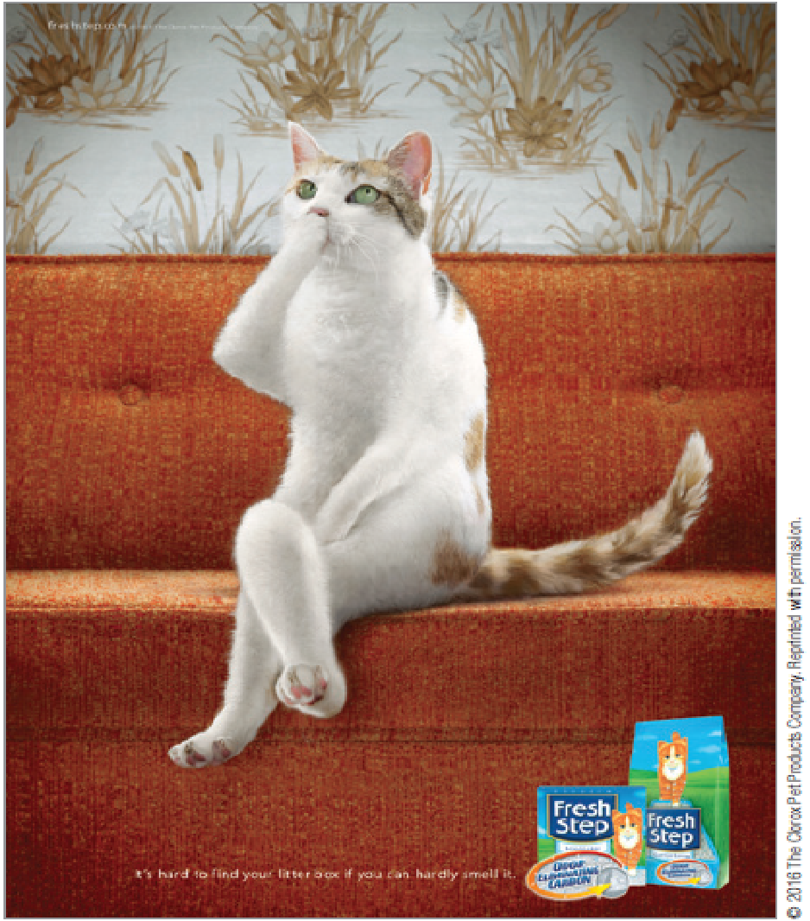
Tonality
Tonality refers to the mood or attitude the message conveys:
Straightforward
Humor
Dramatic
Romantic/Sexy
Fear appeal ads
Notes:
Tonality refers to the mood or attitude the message conveys. Some common tonalities
include the following:
• Straightforward: Straightforward ads simply present the information to the audience in a clear manner.
• Humor: Consumers, in general, like humorous, witty, or outrageous ads, so these often provide an effective way to break through advertising clutter. But humor can be tricky because what is funny to one person may be offensive or stupid to another. In addition, humor can overpower the message. It’s not unusual for a person to remember a hilarious ad but have no idea what product it advertised.
• Dramatic: A dramatization, like a play, presents a problem and a solution in a manner that is often exciting and suspenseful—a fairly difficult challenge in 30 or 60 seconds.
• Romantic: Ads that present a romantic situation can be especially effective at getting consumers’ attention and at selling products that people associate with dating and mating. That’s why fragrance ads often use a romantic format.
• Sexy: Some ads appear to sell sex rather than products. Sex appeal ads are more likely to be effective when there is a connection between the product and sex (or at least romance). For example, sex appeals will work well with a perfume but are less likely to be effective when you’re trying to sell a lawn mower.
• Apprehension/fear: Some ads highlight the negative consequences of not using a product. Some fear appeal ads focus on physical harm, while others try to create concern for social harm or disapproval. Mouthwash, deodorant, and dandruff shampoo makers and life insurance companies successfully use fear appeals.

Slide 24
Pretest What the Ads Will Say
Advertisers try to minimize mistakes by getting reactions to ad messages before they actually place them
Data from pretesting research may come from either quantitative (e.g., surveys) or qualitative (e.g., focus groups) sources

Slide 25
Where to Say It: Traditional Mass Media
TV is often the medium of choice, but is expensive
Radio is flexible but is declining in use
Newspapers are excellent for local ads
Magazines are varied in scope and can target local markets with selective binding

Slide 26
Where to Say It: Branded Entertainment
Advergaming is brand placements in video games
Native advertising is an execution strategy that mimics the content of the website where the message appears

Slide 27
Where to Say It: Support Media
Directory advertising is information-focused advertising such as the Yellow Pages
Out-of-home media reaches people in public places
Place-based media transmits messages in public places where certain people congregate (airports, doctors’ offices, etc.)

Slide 28
Where to Say It: Digital Media
Owned media may include websites, blogs, Facebook, and Twitter accounts.
Controlled by company, effective for relationship building
Paid media includes display ads, sponsorships, and paid key word searches.
Most similar to traditional advertising, less trusted by consumers
Earned media refers to word of mouth or buzz on social media.
Most credible to consumers, no company control

Slide 29
Ethical/Sustainable Decisions in the Real World
The Internet is an open source revolution.
Ad fraud and ad blocking are rampant.
These cost advertisers $8 to $18 billion a year.
Is it ethical for ad networks to block ads intended for consumers’ devices?

Slide 30
When and How Often to Say It
A media schedule is a plan that specifies exact media to use and when to use it.
Reach is the percentage of the target market that will be exposed to the media vehicle.
Frequency is the average number of times a person in the target group will be exposed to a message.
Gross rating points compare effectiveness of different media vehicles.
Cost per thousand is the cost to deliver a message to 1,000 people or homes.

Slide 31
Media Scheduling
A continuous schedule maintains a steady stream of advertising throughout the year.
A pulsing schedule varies the amount of advertising throughout the year based upon when the product is likely to be in demand.
Flighting is an intense form of pulsing, in which advertising appears in short bursts with periods of little or no activity.

Slide 32
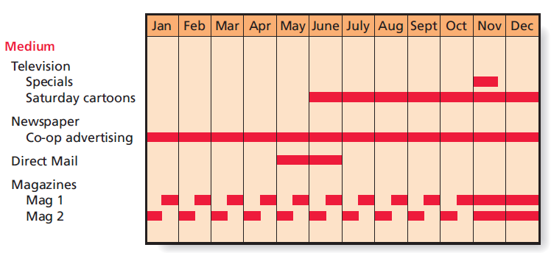
Example: Media Schedule for a Video Game

Slide 33
Sales Promotion
Sales promotions are programs designed to build interest in or encourage purchase of a good or service during a specified period.
How does sales promotion compare to advertising?
Both are paid promotional activities with identifiable sponsors
Differ in that sales promotions typically have a more immediate short-term objective.

Slide 34
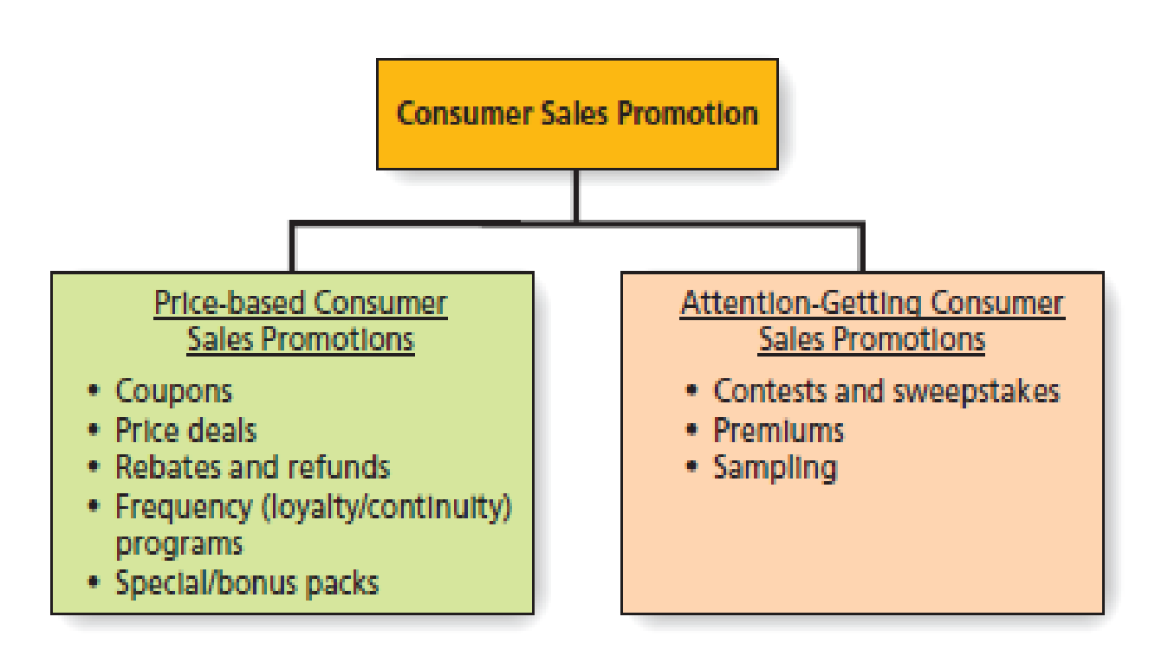
Types of Consumer Sales Promotion
Notes:
Price-based consumer sales promotions target consumers where they live—their wallets. They emphasize short-term price reductions or rebates that encourage people to choose a brand—at least during the deal period. They may take several forms:
Coupons: These certificates, redeemable for money off a purchase, are the most common price promotion and the most popular form of sales promotion overall.
Price deals, refunds, and rebates: In addition to coupons, manufacturers often offer a temporary price reduction to stimulate sales. This price deal may be printed on the package itself, or it may be a price-off flag or banner on the store shelf. Alternatively, companies may offer refunds or rebates that allow the consumer to recover part of the purchase price via mail-ins to the manufacturer.
Frequency (loyalty/continuity) programs: Frequency programs, also called loyalty or continuity programs, offer a consumer a discount or a free product for multiple purchases over time.
Special/bonus packs: Another form of price promotion involves giving the shopper more product instead of lowering the price. A special pack also can be in the form of a unique package, such as a reusable decorator dispenser for hand soap.
Attention-getting consumer promotions stimulate interest in a company’s products. Some typical types of attention-getting promotions include the following:
Contests and sweepstakes: According to their legal definitions, a contest is a test of skill, while a sweepstakes is based on chance.
Premiums: Premiums are items you get free when you buy a product. General Mills Cheerios brand cereal has given away over 8 million bilingual children’s books inside Cheerios boxes in the past 11 years.
Sampling: Product sampling encourages people to try a product by distributing trial size and sometimes regular-size versions in stores in public places such as student unions, grocery stores and warehouse clubs, or through the mail. Companies like Procter & Gamble, Unilever, S.C. Johnson, and GlaxoSmithKline are readily taking advantage of websites such as Freesamples.com and Startsampling.com that distribute the firms’ samples and then follow up with consumer-satisfaction surveys.

Slide 35
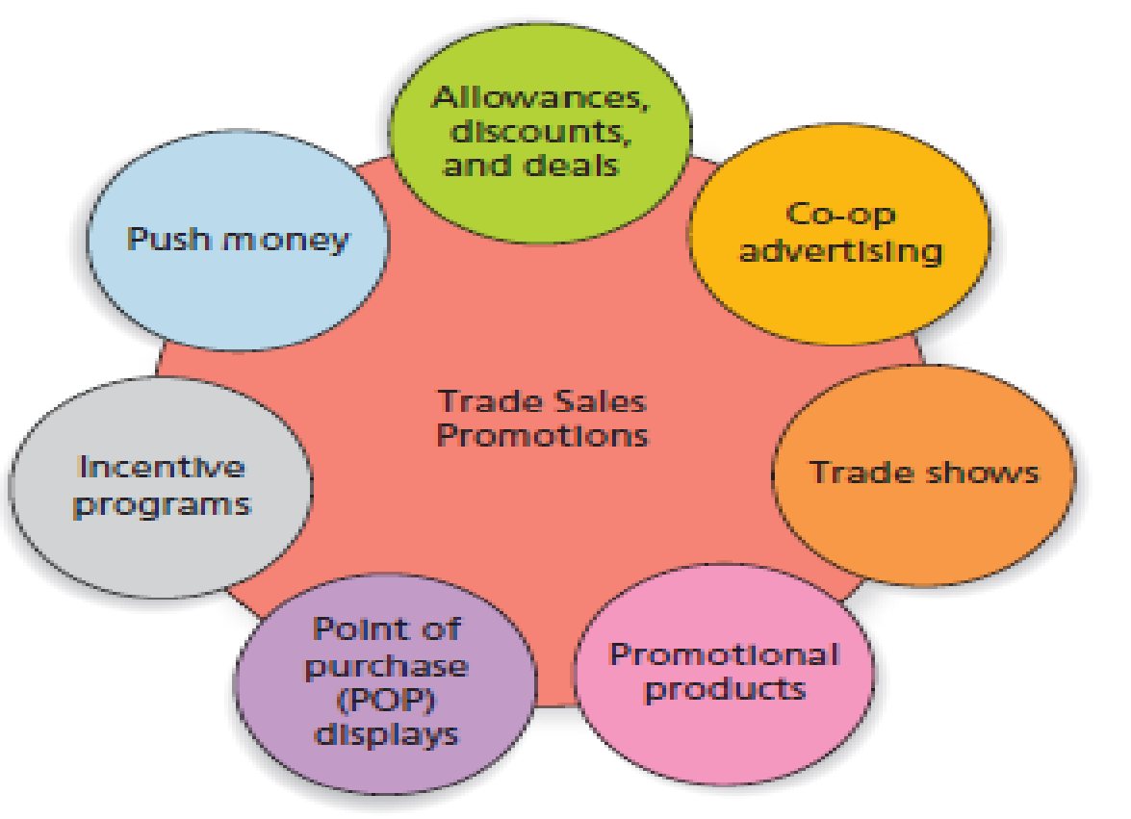
Trade Sales Promotions

Slide 36
Sales Promotion Designed to Increase Industry Visibility
Other types of trade sales promotions increase the visibility of a manufacturer’s products to industry channel partners.
Trade shows
Promotional products
Point-of-purchase displays
Incentive programs
Notes:
Several trade promotions are designed to increase industry visibility:
Trade shows are industry events held in large convention centers where vendors, suppliers, manufacturers from a given industry get together to share information about new products, generate sales leads, and make contacts. Only those who work in an industry can attend—these are not the same as the consumer product shows that you might have attended at the local convention center.
Promotional products include branded items such mugs, clocks, mouse pads, polo shirts, pens and the like that list the name and logo of an organization. Members of the sales force often use promotional products as favors that are given to prospects or existing clients to build awareness or create good will.
Point-of-purchase (POP) displays include temporary, semi-permanent, and permanent displays, as well as in signs, banners, floor ads, plastic reproductions of products, shopping cart ads and in-store television. POP displays offer a variety of benefits, including increasing consumer awareness of products, increasing impulse buys, reinforcing mass advertising and increasing off-shelf merchandising space. Retailers are generally overwhelmed with POP displays; manufacturers typically find that a merchandise allowance is helpful in convincing retailers to use displays.
Incentive programs are often aimed at the firm’s own sales force. Push money is often used to motivate the sales force to sell older models, unpopular colors, or just to sell more product or demonstrate a certain item. Push money may take the form of cash bonuses, trips, or prizes.

